Slide 1
Machine Learning
[Automated Answering Webapp]

Slide 2

About You
A few words about you. What do you do, Where do you work, what are your interests..
I am a 3rd year Undergraduate. I am completing my B.Tech degree in IT from Jaypee Institute of information technology, Noida. I am a machine learning enthusiast and love developing practical products combining web and Machine learning or Android and Machine Learning.

Slide 3
Core Idea
Explain the given problem statement in your words
To ease the workload of the customer care staff of ABC corp., it is required to build a system that automates the task of solving user queries and problems. The required system must generate relevant answers for a user query based on previous responses by the consulting team and the user manuals that the consultants refer for solving FAQs. The system should understand queries based on context and should map it to most similar query that has already been asked before in some way or the other.

Slide 4
Implementation Overview
Explain the solution submitted in your words
A webapp is created which hits the API written in python and flask.
WebApp is divided in 2 parts – Query asking and Troubleshoot guide search.
Two NLP techniques are used in layers to find the most similar query in the User-Manuals and in the Sample Input to the user query.
Firstly the 10 most similar queries are generated using the basic Tf-Idf model.
Then the most similar query out of those 10 is decided by using the LSI model.
The solution that maps to this query is returned to the user to see if it helps him or not.

Slide 5
Technology/Tool/Components used
Explain the Technologies, Languages used in your solution.
HTML, JAVASCRIPT, CSS is used for creating the webapp.
Python is used to write the API code and Flask is used to connect the app to API. (Pycharm IDE is used)
Modules used in python:
Gensim for similarity indices
Numpy for array manipulation
NLTK for text processing.
Pandas for dataset creation and manipulation
Python-docx to read the document file.
NOTE: Highly recommend Mozilla Firefox browser for running the app for better performance and appearance.

Slide 6
Client/User UI of Webapp
(Mozilla Firefox)
Architecture overview
Explain the Architecture you followed in your solution
FAQ/straightforward Query
Troubleshooting (symptom)
API (Backend)
Find most relevant
answer
Calculate similarity
With available statements
GENSIM
Fetch user query

Slide 7
Elaboration of the usage
How does your application work.
Built a WebApp using HTML, CSS, JAVASCRIPT which gave a platform to the user to interact with the system. An AJAX script is created to map the form input with a request that can be sent to an API.
Built a flask app in python which acts as a local API that responds to the request sent by the webapp. The request is in form of a query statement that user asks.
The API fetches the query.
The API then creates a dictionary of all the words present in the queries or FAQs in available data source that are sampleInput file and the user manual.
From the dictionary it creates a BagOfWords. On this Bag of words it implements the Tf-idf model and compares the available query to the user query and stores the 10 available statements with the highest score. (top 10 are chosen as on observing top 10 statements were always enough to get all the similar sentences to the user query).
Now the process is repeated for these 10 statements but now the Latent Semantic Index (LSI) technique is applied on the BagOfWords formed by these 10 statements. LSI approach focuses more on the contextual part of the speech. The statement with the highest score is stored as the most relevant statement to the query and the response/solution which maps to this statement is returned to the user and is shown on the webapp.

Slide 8
Number of Output Questions Working
In the output sheet we provided how many questions are showing the correct answers and what are those.
From the sample output file –
9/9 test cases gave correct results.(100%)
From self formed test cases --
12/14 test cases gave correct results.(86%)

Slide 9
Prototype Demo
Add a video link of the workable solution. Please cover as many output scenario’s as you can show from the output excel provided. (Mandatory)
Link to video: https://cl.ly/2f3Y3o3E3p0S
Click to view the video of the working webapp.
NOTE: The video is also provided in the main folder “demo video.mp4”

Slide 10
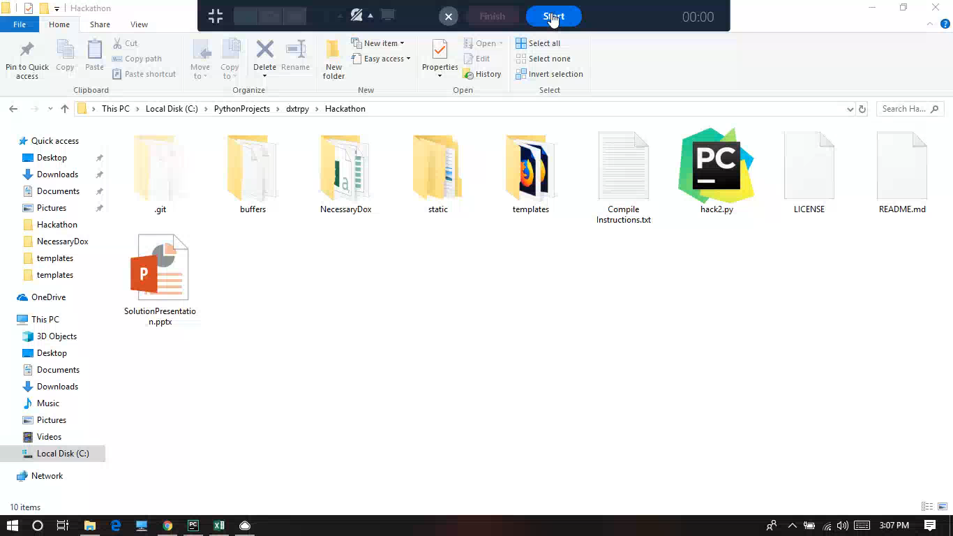
Please ignore the minor sound disturbances.

Slide 11
Source Code
GIT Link and Compile Instructions, Solution Hosted URL
GIT URL: https://github.com/codex-hammer/hackathon
Compile Instructions: Provided in the README of the Git repository as well as in the root folder of the app in the file ‘Compile Instructions.txt’.

Slide 12
Completeness
Mark the area’s which have been completed and tested. They will be a part of the evaluation parameters.
Area | Description
Performance – How did you measure the performance of this system. | By testing with queries in the sampleOutput.xlsx file and with some self formed queries.
Usability – How usable is your solution | Anyone with a browser can use this application.
Completeness – What has been completed. | The required deliverables of the project are completed.
Pending – What are the items which are pending | Taking input for approval/disapproval of the solutions from the user.

Slide 13
Possible Improvement
Any Improvements you want to add?
The Image solutions in the Troubleshooting document could not be processed due to the inability of python language to do so as for now.
Weights could be assigned to emphasize the solutions according to how frequently users got helped by the particular solutions.
Fetching/Scraping information from the internet when user problems go out of context range of the available dataset.

Slide 14


